Slide 1
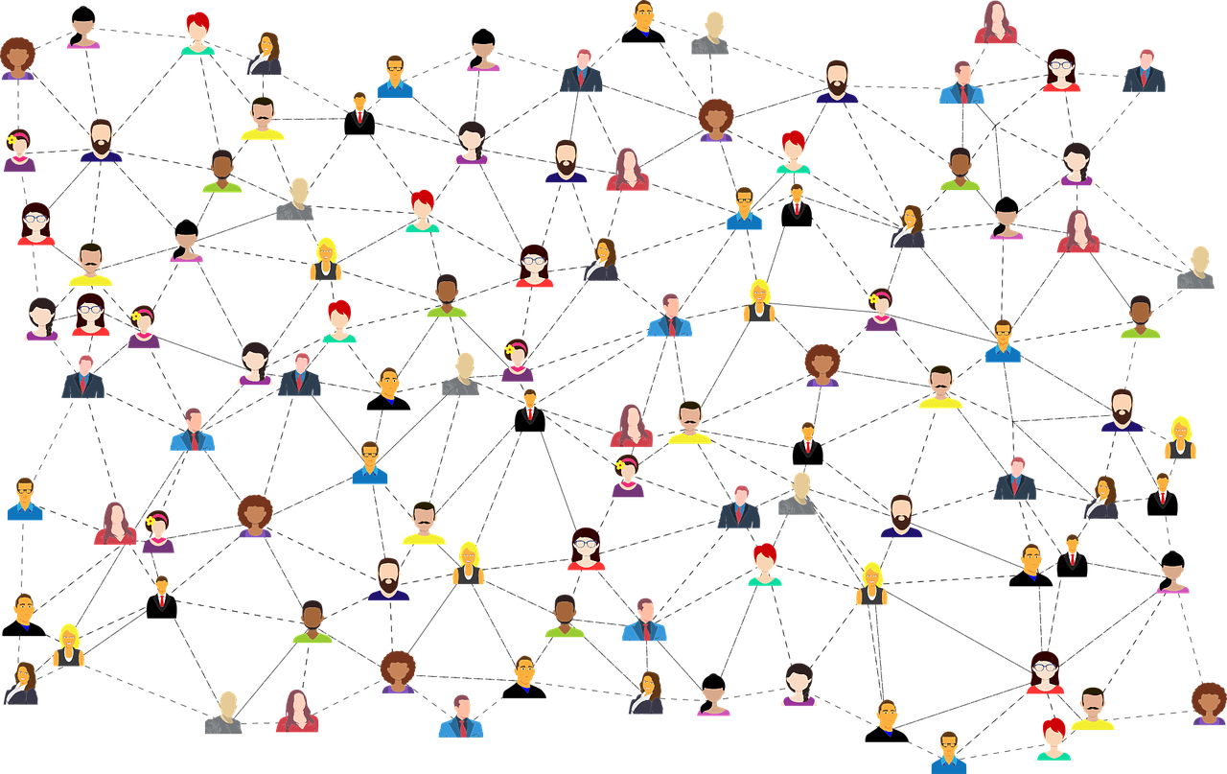

MEDIA & THE PUBLIC
Week 5 Opinion leadership in new media
Ryan Wang
ryanyang@psu.edu

Slide 2

Examining Characteristics of Opinion Leaders in Social Media: A Motivational Approach (Winter & Neubaum, 2016)

Slide 3
Background
Social media as an arena for opinion leader
Affordance of SNS:
Status updates & send personalized messages
Forward news / Add comments / Endorsement
A larger audience (compared to f2f communication)
Strengthen the influence of information/opinion dissemination
A more strategic selection of content
Backfire effect of the broader composition of the audience
Facebook v. Twitter
The ratio of interpersonal contacts could be higher
A more closed replication of the offline friendship network

Slide 4
Background
Opinion leaders in 1950s and today:
Personal predisposition (who one is)
Personality strength
Extraversion
Domain specific factors (what one knows)
Political interest
Social connection (who one knows)
The number of friends
Motives
Information
Persuasion
Self-presentation

Slide 5
How do the authors measure the following…?
Personal predisposition (who one is)
Personality strength
Extraversion
Domain specific factors (what one knows)
Political interest
Social connection (who one knows)
The number of friends
Motives
Information
Persuasion
Self-presentation

Slide 6
What are research questions & hypotheses?
Regression analysis
H1: Personality strength predicts SNS opinion leadership and the frequency of opinion expression.
RQ1: Is there a relation between extraversion and SNS opinion leadership as well as the frequency of opinion expression?
H2: Political interest predicts SNS opinion leadership and the frequency of opinion expression.
RQ2: What is the relationship between the number of friends and opinion leadership on SNS?
H3: The motives of (1) disseminating information, (2) persuading others, and (3) creating a positive self-presentation predict opinion leadership on SNS.
H4: The motives of (1) information and (2) persuasion predict private opinion expression on SNS.
H5: The motives of (1) information, (2) persuasion, and (3) self-presentation predict public opinion expression on SNS.

Slide 7
What are research questions & hypotheses?
Mediation analysis:
H6: The relationship between personality strength and SNS opinion leadership is mediated by the motives of persuasion and self-presentation.
H7: The relationship between political interest and SNS opinion leadership is mediated by the motives of information and persuasion.
H8: The relationship between extraversion and SNS opinion leadership is mediated by the motive of self-presentation.

Slide 8
How do the authors measure the following…?
Personal predisposition (who one is)
Personality strength
Extraversion
Domain specific factors (what one knows)
Political interest
Social connection (who one knows)
The number of friends
Motives
Information
Persuasion
Self-presentation

Slide 9
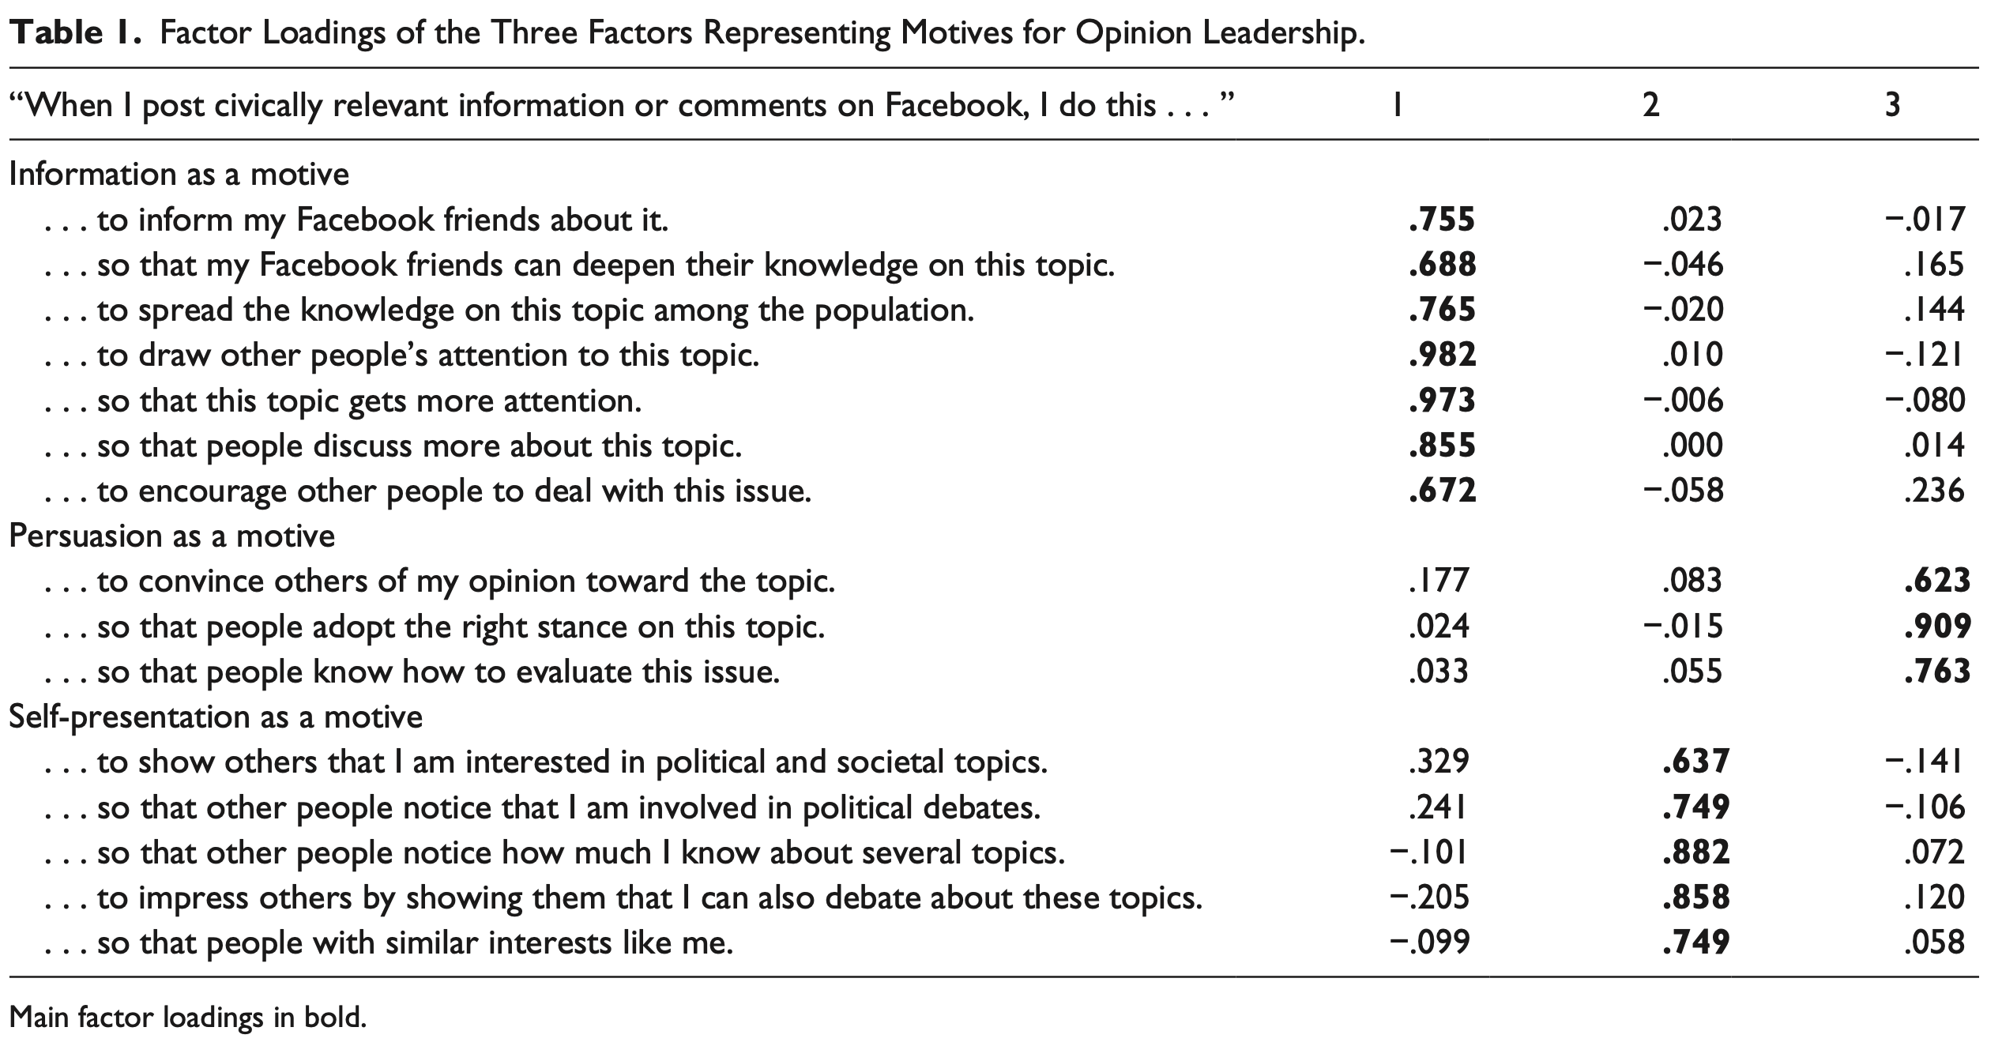
Measurement

Slide 10
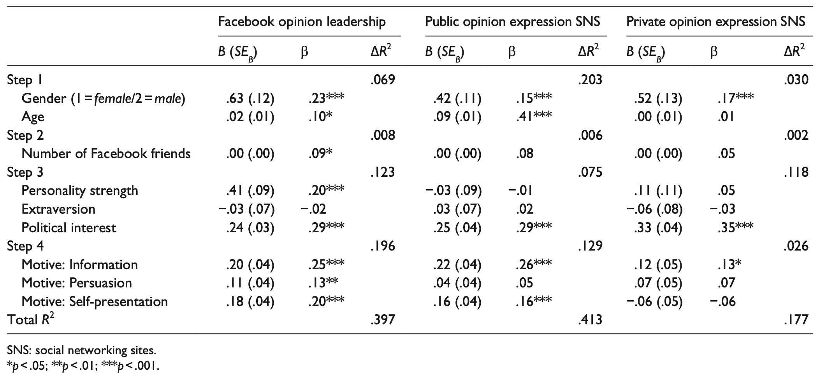
Main results
RQ2
RQ2
RQ2
H1
H1
H1
RQ1/H8
RQ1/ H8
RQ1/ H8
H2
H2
H2
H5(1)
H4(1)
H3
H5(2)
H4(2)
H5(3)

Slide 11
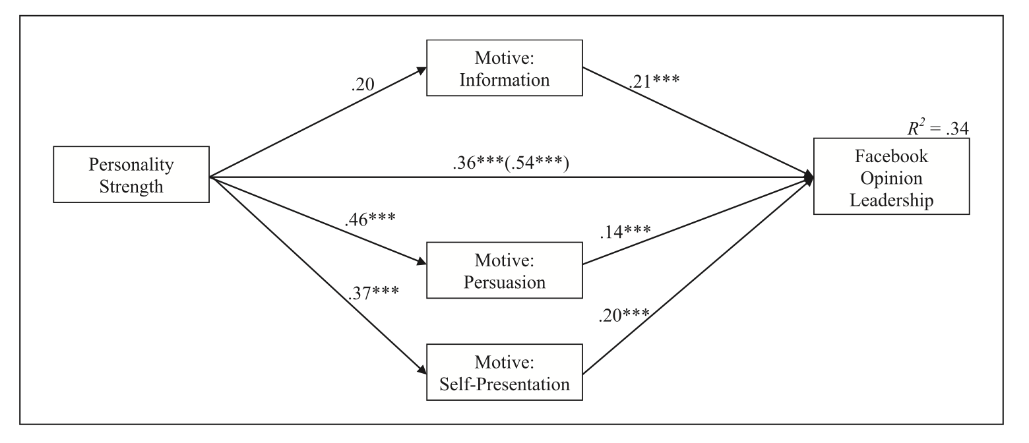
Main results
H6

Slide 12
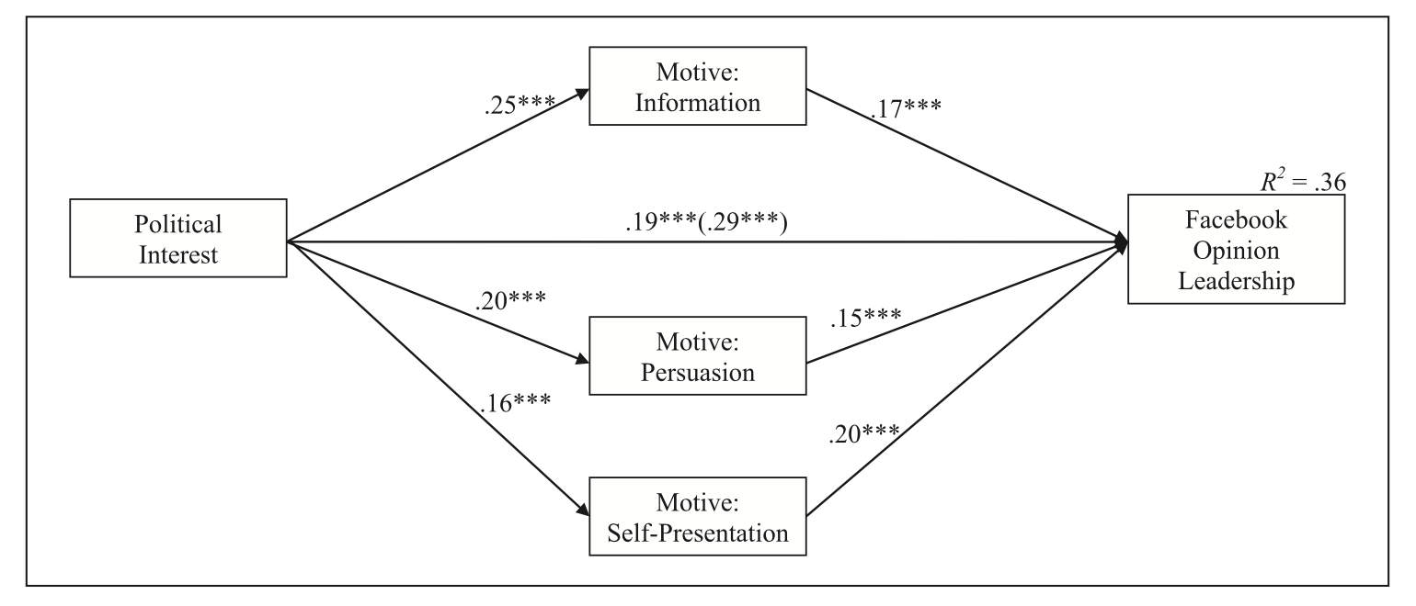
Main results
H7

Slide 13
Key takeaways
The classic concept of opinion leaders by Katz & Lazarsfeld (1955) is still able to serve as a framework to understand current dynamics of public opinion in social media
Who one is:
The motivational approach: why people with greater personality strength aim to be opinion leaders
Extraversion did not emerge as a predictor of opinion leadership on social media (compared to f2f communication)
What one knows:
The political interest is the most consistent predictor of opinion leadership and opinion expression throughout all channels.
Who one knows:
The number of Facebook as an indicator of gregariousness: a large network is helpful for spreading information and opinions (but not for frequency of talk)
Limits: convenient sample; time validity (election year); self-report

